Slide 2
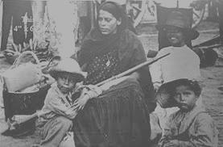
The Contributions of Women to the Mexican Revolution as Seen through the Eyes of Jesusa Palancares
Ana Topete
Capstone 2014
Advisors: Dr. Gómez, Dr. Urioste, Dr. Zielina

Slide 3
Index
Mexican Revolution 1910-1920
Significance of my study
Author: Elena Poniatowska
The novel Here’s to you, Jesusa! (Hasta no verte, Jesús mío)
The character Jesusa Palancares
Definition of Soldadera (camp follower)
Soldadera’s contributions
Conclusion
Bibliography

Slide 4
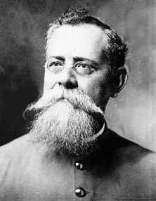
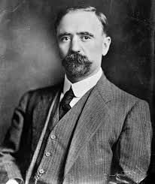
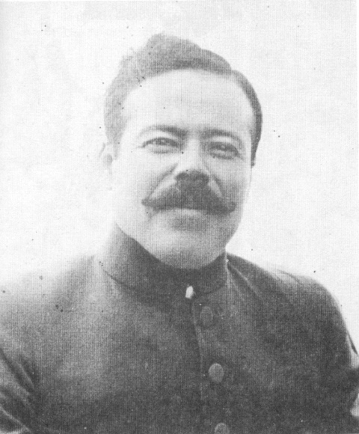
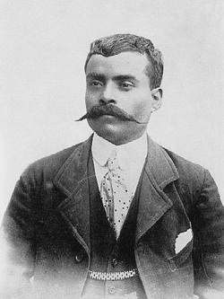
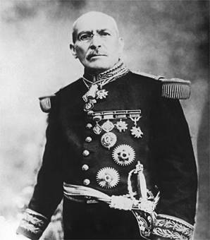
Mexican Revolution 1910-1920
Unfair distribution of wealth and land, exploitation of workers, the political and administrative corruption, and denial of democracy were some of the main causes of the revolutionary movement.
Main characters: Francisco Madero, Emiliano Zapata, Francisco Villa, Victoriano Huerta, Venustiano Carranza

Slide 5
These brave men are the main characters that have been highlighted by history.
We also know of the courageous farmers that made this rebellion possible, but we do not know much about the women who participated in the revolt.
History has excluded the women’s participation in the Mexican Revolution.

Slide 6
Novel of the Revolution
Years after the Revolution concluded a new literary genre was created, the Novel of the Revolution.
Most of the main personages and authors of this genre are men

Slide 7
Significance of study
The role of women during the Mexican Revolution has been underrepresented in the historical texts
During and after the Revolution, corridos were written about the brave men who were in the front lines of the battles, very few were written about women
We know of courageous characters who were participants in this event that changed the history of Mexico
Authors such as Elena Poniatowska have dedicated much of their career to highlighting the contributions of women in the Mexican Revolution.
Her novel Here’s to You, Jesusa!, is regarded as one of the most notable novel that depicts the role of women during the Mexican Revolution

Slide 8
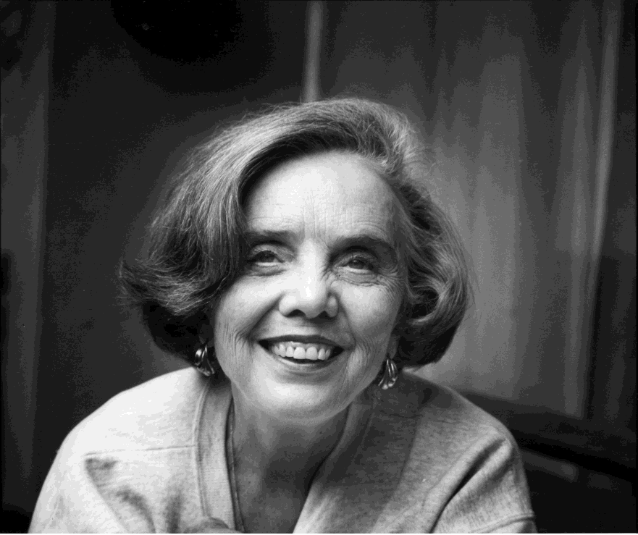
Elena Poniatowska
Born in May 19, 1932 in Paris, France
Her family migrated to México in 1942 trying to get away from the Second World War
Since then, she has reside
in México, which she
considers to be her homeland
She writes in different genres.
Poniatowska is best known for her testimonials
Just recently this year she won the Cervantes literary award, which equals the Nobel Prize.

Slide 9
Hasta no verte, Jesús mío
Here’s to You, Jesusa, was based on an actual camp follower, Josefina Borquéz.

Slide 10
Here’s to You, Jesusa!
Four main characters in the story:
1. Jesusa
2. Felipe, Jesusa’s father
3. Pedro Aguilar, her husband
4. Evarista, stepmother
There are different themes: conformism, humiliation, rivalry, migration, death, machismo, camp follower (soldadera), religion idealization of man, violence, wisdom, war, and poverty

Slide 11
Here’s to You, Jesusa!, Summary
Jesusa , who is the protagonist, narrates the events of her life through time . Since an early age she lost her mother; his father looked for other women to take care of Jesusa and her younger brother, Emiliano. This search was in vain because Jesusa did not want any other woman near her father. Evarista was the only woman she accepted; it was that woman that taught her to fend for herself.

Slide 12
At an early age she began her revolutionary life next to her father, Felipe. It was there where he met Pedro Aguilar, whom she married at the age of fifteen. Despite being a relatively young wife, Jesusa fulfills her duties like any other woman in the Revolution. Jesusa was only eighteen years old when her husband died, during a battle against Villa.
Carranza 's government denied her the right to obtain that belonged to her, it was her right to get compensated for her participation in the Revolution.

Slide 13
Throughout her life she had different jobs in order to survive. She lived in a number of places in different states of the Mexican Republic. Thanks to these experiences, she met many different people.
Although several times she had the opportunity to remarried, she never did.
She never had children of her own, but did adopt three boys, who stole the little she had and abandoned her.

Slide 14
Cont.
Jesusa said she was a very intelligent woman and used that intelligence to survive. She was very spiritual and used that as a cure for her physical and psychological illnesses.
In the end, Jesusa wanted to die in some distant hill, like the hills where he spent her childhood.

Slide 15
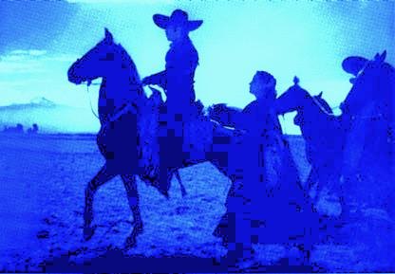
Camp follower (soldadera)
To develop this research I have chosen one of the themes, the camp follower. “Soldadera”

Slide 16
The word soldadera (camp follower) defines women who accompanied the soldiers and fought with them during the Mexican Revolution.
It is a word that does not exist in the dictionary
This shows how little appreciation women received for their service to their country

Slide 17
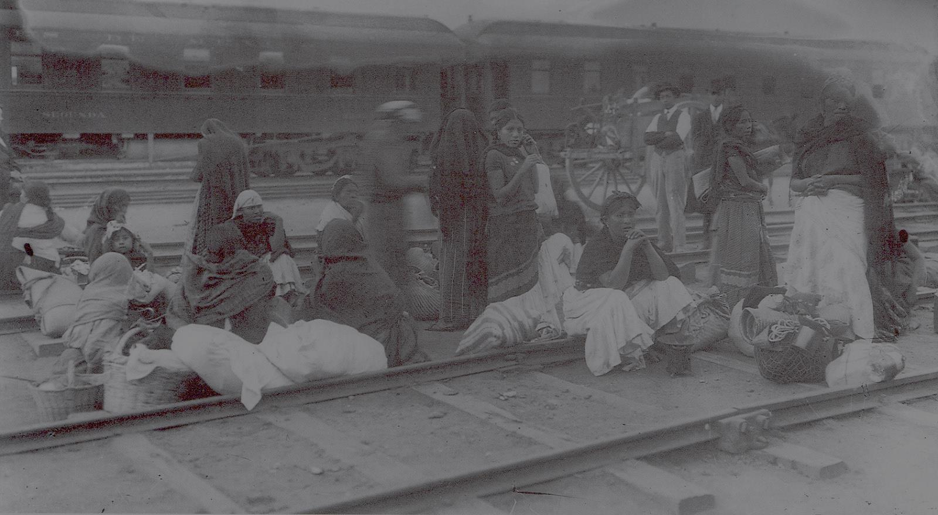
Women’s Contributions
The presence of women –soldaderas was fundamental for the armies’ survival.
Like Jesusa, women had different roles during the Mexican Revolution.
For this presentation, I will focus only on a few of the contributions.
1. Wife
2. Nurse
3. Cook

Slide 18
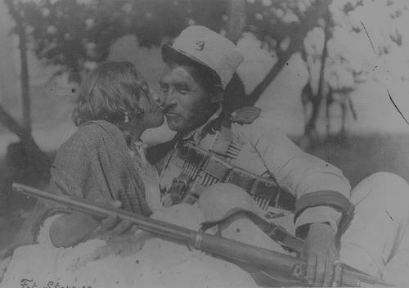
As a Wife
One of the most important contributions that women made was to follow their husbands everywhere they went during the war.
As a wife, she had the responsibility to look after her husband's well being.
She carried her home with her
Women had to survive under extreme circumstances, they were loyal wives

Slide 19
Abused Wives
The women had to not only survive the violent war, but also violence from their own husbands.
As Jesusa explains, "Para todo golpeaba Pedro , como la mayoría de los hombres de la corporación que trataban a sus mujeres a punta de cintarazos: <Camine, chencha, ándele>, el caso era traerlas a mal traer. Pedro agarraba y me daba con la cacha de su pistola en la cabeza..." (128).

Slide 20
Cooks
At the beginning of the Revolution, many armies denied women the access to be part of them. Men discovered they were unable to cook for themselves, so they began allowing women in the troops.
Women were in charge of providing their men and children with food
Jesusa narrates,”A nosotras las mujeres nos mandaban de avanzada... Al llegar procurábamos prepararles la comida” (86,87).

Slide 21
Many wives did not receive money from their husbands, so like Jesusa, they had to figure out a way to provide for him and her children
Jesusa knew that if her husband passed away, she would be almost forced to find another man in order for her to survive

Slide 22
Jesusa, like most of the soldaderas did everything possible to have food for her husband Pedro, for the soldiers.
Since many towns favorite an army, when they knew the opposites were coming, they hid everything. In most cases they refused to provide women with food, so the camp followers were forced to use violence in order to obtain some food.
Soldaderas were not allowed to ride the horses, so many occasions they had to walk long kilometers in order to find something to eat.

Slide 23
At the arrival of any army, the women that were left in the town were forced to cook for the men
Some armies would take the women for several days to serve as cooks, they would released them once they were no longer needed.
Women had to be able to cook anywhere, at any time. In long trips, they had to cook on top of the trains
When water was scarce, it was extremely difficult to obtain it

Slide 24
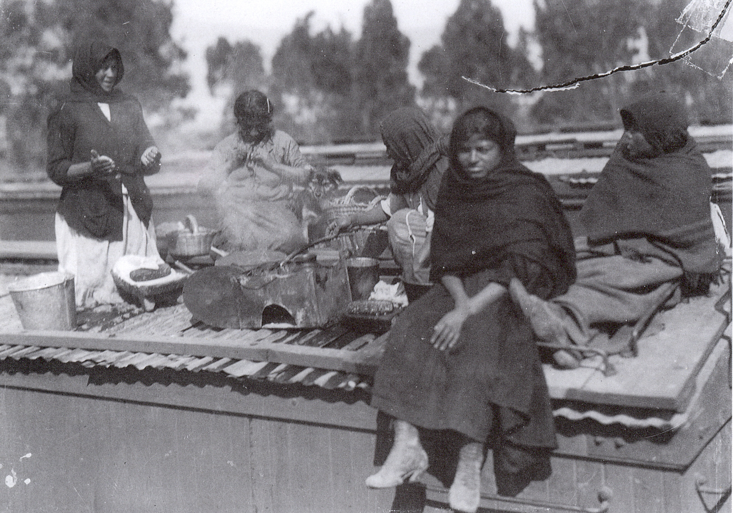

Slide 25
Contribution as a Nurse
Jesusa, also served as a nurse, “Mientras fuimos Pedro y yo a la Hacienda del Salado, ordenaron que la gente del general Juan Espinosa y Córdoba fuera a levantar el campo porque los villistas habían volado el tren de pasajeros de Conchos a Chihuahua...” (165).
When there was a hospital near by, they would take them there. Unfortunately, many times they did not have access to a medical facility, so they would take the wounded back to their camps.

Slide 26
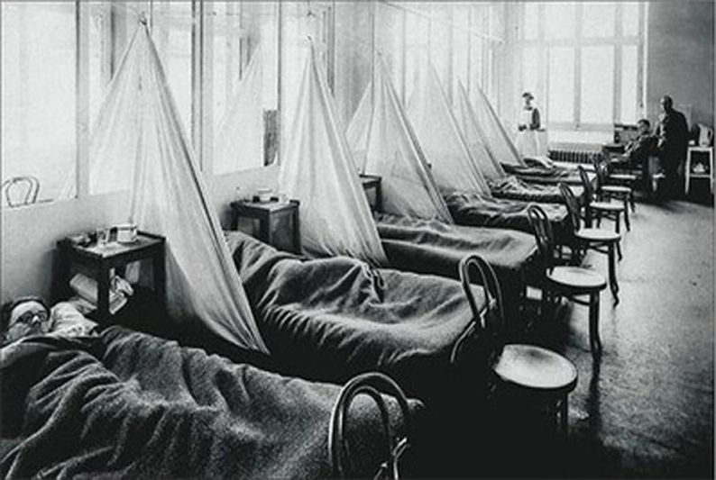

Slide 27
Many of them followed the troops and made provisional hospitals wherever it was necessary
Women that stayed in the towns, turned buildings into hospitals.
An example of such woman is Beatriz González, whom in her hometown in the state of Zacatecas turned a school into a hospital. Her hospital welcomed any soldier in need, for her all men were the same; they were all mexicanos

Slide 28
These are some of the aspects that I have examined in my work
I want to clarify that I have also examined the abuses committed against women

Slide 29
Example:
Widows had the right to receive their husbands’ compensation, but not even that money was given to them
With their children, they went back home without anything
Many veteran women died in extreme poverty, such is the case of Petra Herrera

Slide 30
Abuses
When Venustiano Carranza became president, the armies made up by women were dispersed
At the end of the Revolution male veterans received compensation
Women did not receive anything for their service to the country
Jesusa recalls, “-Si estuvieras vieja [Jesusa], te pensionaba el gobierno, pero como estás muy joven no puedo dar orden de que te sigan pensionando... Pero Carranza se quedó con mi dinero, maldecido. A él si lo mantuvo y sigue manteniendo a los revolucionarios que están en la gloria...” (178).

Slide 31
Abuses
Not all the women that participated in the Revolution were there voluntarily, some were taken by force
Although some women were able to return to their hometowns, most of them stayed with the troops in order to survive
They were sexually abused by strangers, and many times by their own husbands
Many that were forced to follow the armies turned into prostitutes because they needed money to survive and had no one to protect them

Slide 32
Conclusion
Women made immense contributions to the Revolution. Although they are not given much credit, it was they who kept the war alive; serving as cooks, wives, mothers, lovers, spies, nurses, soldiers, etc.. Jesusa Palancares in the novel Here’s to You, Jesusa! is a vivid example of the contributions of women in the Mexican Revolution.

Slide 33
Thanks you for your attention!

Slide 34
Bibliography
Arrizón, Alicia. "Soldaderas and the Staging of the Mexican Revolution." TDR 42.1(1998): 90-112. Web.
Bruce-Novoa, Juan. "La novela de la Revolución Mexicana: la topología del final." Hispania 74.1 (1991): 36-44. Web.
Chang-Rodríguez, Eugenio. Latinoamérica: su civilización y su cultura. 4th ed. Boston: 2008. Print.
---. "La novela de la Revolución Mexicana y su Clasificación." Hispania 42.4 (1959): 527-535. Web.
Enamorada. Dir. Emilio Fernández. Panamerican Films. Film
Green, James N., Smith, Peter H., and Skidmore, Thomas E. Modern Latin America. 4th ed. New York: 2010. Print.
Hancock, Joel. "Elena Poniatowska's Hasta no verte Jesús mío: The Remarking of the Image of Woman." Hispania 66.3 (1983): 353-359. Web.
Lewis, Oscar. "Pedro Martínez". The Mexico Reader. Gilbert M. Joseph and Timothy J. Henderson. London: 2002. 375-386. Print.
La Cucaracha. Dir. Ismael Rodríguez. Azteca Films, 1959. Film.
Macías, Anna. "Women and the Mexican Revolution, 1910-1920." The Americas 37.1 (1980): 53-82. Web.
Memorias de un mexicano. Dir. Salvador y Carmen Toscano. Film.
Mendoza, Vicente T. El Corrido Mexicano. Distrito Federal: 1995. Print.
Poniatowska, Elena. Hasta no verte, Jesús mío. 1ra ed. de bolsillo. Barcelona: 2002. Print.
---. Las Soldaderas. Distrito Federal: 1999. Print.
Resendéz-Fuentes, Andrés. "Battleground Women: Soldaderas and Female Soldiers in the Mexican Revolution." The Americas 51.4 (1995): 525-553. Web.
Robles, Fernando, and Elena Poniatowska. La Adelia. Distrito Federal: 2006. Print.

